Slide 1
Maistor.bg

Slide 2
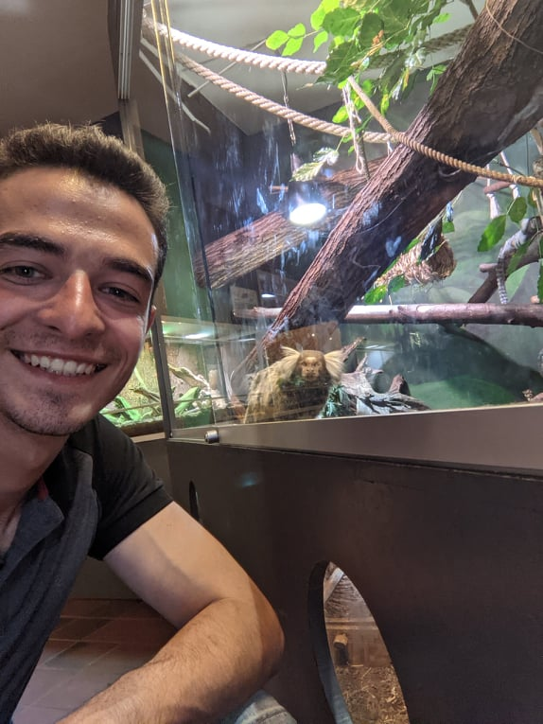
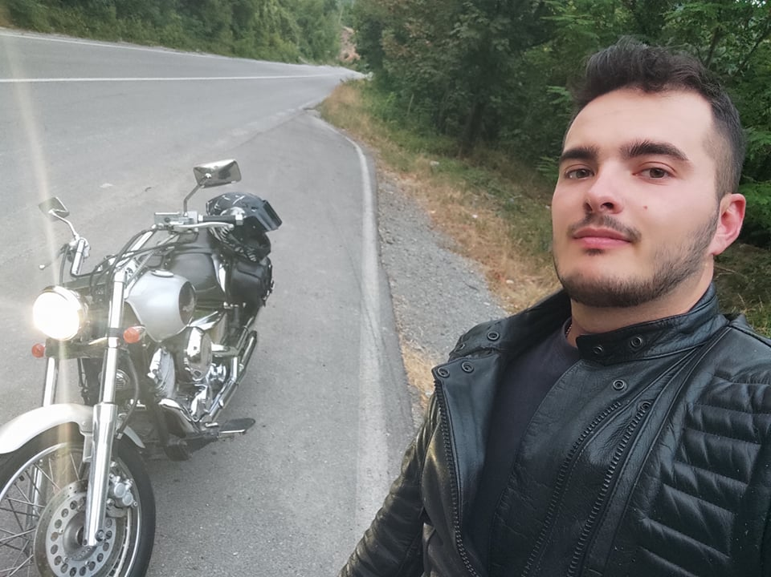
Who are we?
Tsvetelin Takiev
Student at New Bulgarian University
Martin Ivanov
Moto enthusiast

Slide 3
Main functionality
Registration and login
Upload a profile picture
Email and SMS verification for account
Creating a post
Making an offer for a post
Accepting offer from worker
Comment and rate a worker
Add category and delete category(admin)

Slide 4
What we used?
Technologies and API’s
Java 8
Spring Boot
Spring Rest
Spring Data JPA
Maven
Hibernate
JPA
MySQL
BCrypt
Lombok
Model Mapper
Twilio
Scoop
Java MailSender
Software
InteliJ IDEA
Postman
Git
MySQL Workbench

Slide 5
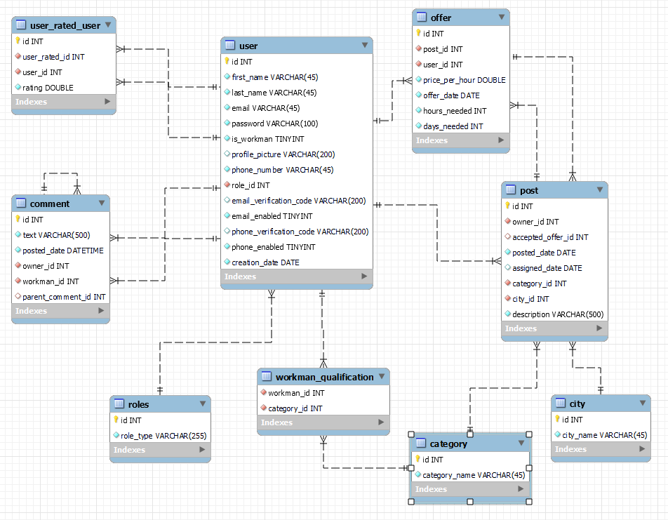
Database

Slide 6
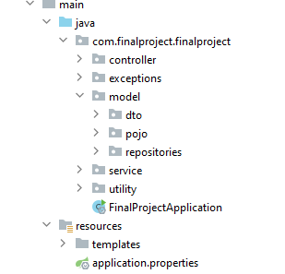
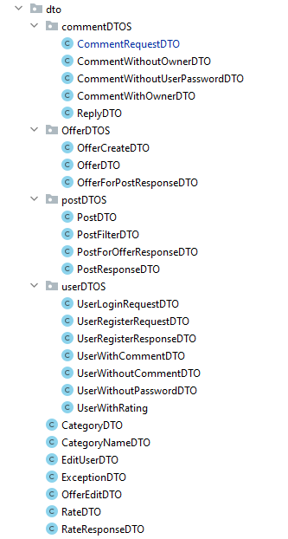
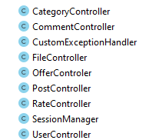
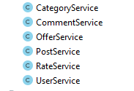
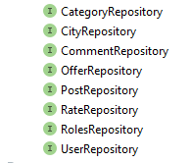
Class structure

Slide 7
Demo
Let’s see how everything works!

Slide 8

Questions?

Slide 9
Thank You !

